Slide 1

Presentation on
Violence Detection using deep learning approach.
Group Members :
17CS036 : Neeraj Patil
17CS040 : Deepak Pitambare
17CS024 : Amruta Kumbhar
17CS046 : Prachi Sabale
Project Guide : Prof. N. S. Devekar
Head of the Dept. : Dr. D.P. Gaikwad.

Slide 2
INDEX
Abstract
Introduction
Problem Statement
Goals And Objectives
Motivation
Literature Survey
Technology Required
System Architecture & Proposed System
Modelling Result and analysis
Conclusion Future Scope
References

Slide 3
Abstract
Nowadays human security against violence is one of the major concern. Violence detection techniques analyze the surveillance camera videos. Over the last few years, these cameras and other surveillance equipment are installed at sensitive areas like ATMs, Government offices, Schools, Hospitals, etc.
For the security against violence, there is a need of generating timely and automated alerts to concern officials to take further action.
The aim is to develop a system for monitoring and analyzing the video streams from surveillance cameras and making the decision about violence.
Frame level features in a video are extracted by employing a CNN after which they are compounded by utilizing a variant which in turn makes use of convolutional gates
CNN used for the analysis of local motion in a video.

Slide 4
Abstract
The Deep learning technique for violence detection is used to classify the violent recognition on the base of data set and extracted features using more convolutional layers.
After assessing contemporary circumstances in the world, it is imperative that there is existential and paramount need of exploiting automated visual surveillance for detecting weapons , which will enhance effectiveness of security operations.
In future we can extend this system by adding weapon detection system using various algorithms like SSD , FasterCNN etc for weapon identifcation.
Therefore with the help of video surveillance we can analyze the presence of violence and a particular event of violence by weapon detection using Deep learning techniques.

Slide 5
Introduction
Security is a major in every domain , due to rise in violent activities and weapons . Earlier surveillance systems were more dependent on human operator.
Now, because of surveillance cameras installed at various public places like offices, hospitals, schools, highways, etc. it can be helpful for capturing useful actions and movements for event prediction and online monitoring.
Having an automated system with the ability to recognize the occurrence of violence in videos with real-time response will enable authority holders to increase safety and take appropriate decisions.
Violence is an abnormal behavior and those actions can be identified through smart surveillance system using which we can prevent further fatal accidents

Slide 6
Introduction
The fundamental goal is to collect categories and recognize the most prominent and effective methods or techniques that are used in violence and anomalous activity detection using deep learning approach.
The aim is to develop an intelligent surveillance system which detects violence or weapons in given video frame using a deep supervised learning approach.
The model incorporates a pre-trained convolution Neural Network (CNN) connected to Convolutional layer.
The model takes the raw video as an input which is subsequently converted into frames and output is a binary classification of violence or non-violence label.
Therefore with the help of video surveillance we can analyze the presence of violence and a particular event of violence.

Slide 7
Problem Statement
Analyzing the presence of violence and a particular event of violence by using Deep learning approach.

Slide 8
Goals And Objectives
In recent years, violence has become a major issue across the globe. So, there is a need to detect violence automatically without human intervention and generate alerts timely to the control crew.
Developing a technique for the automatic analysis of surveillance videos in order to identify the presence of violence and weapon identification.
To develop a system having high accuracy, less false alerts and low computational cost in monitoring and analyzing the video streams from surveillance cameras and making the decision about violence in real-time.

Slide 9

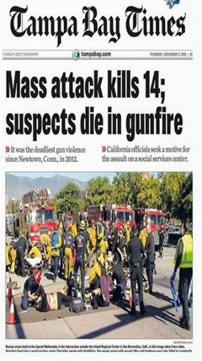
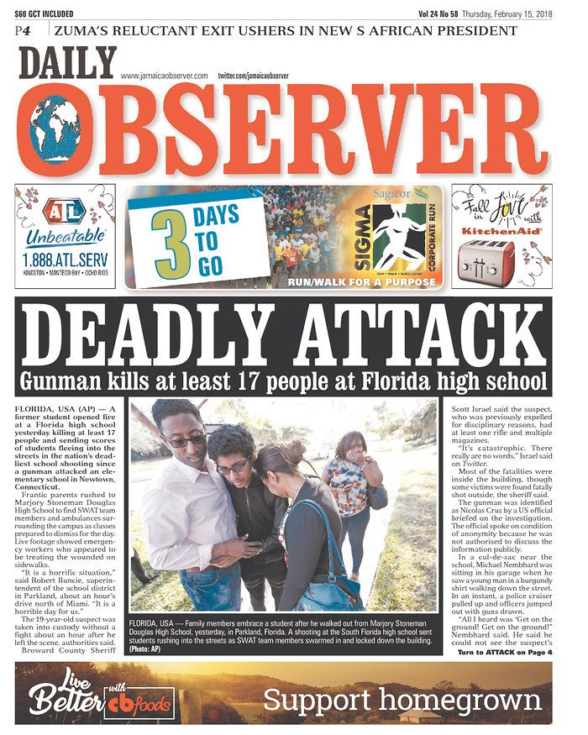
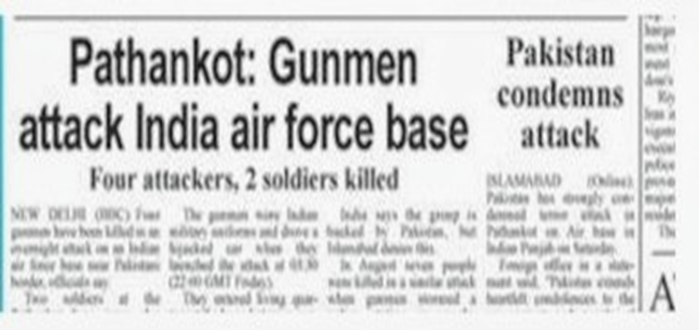
Motivation

Slide 10
Motivation
Today, the amount of public violence has increased dramatically. As much in high schools as in the street. This has resulted in the ubiquitous use of surveillance cameras.
Developing a technique for the automatic analysis of surveillance videos in order to identify the presence of violence and weapon identification.
Research on violence detection in videos is scarce, compared with other video analysis problems.
Existing systems face the problems of low accuracy, high false alerts and high computational cost in monitoring and analyzing the video streams from surveillance cameras and making the decision about violence in real-time.

Slide 11
Literature Survey
Sr No. | Paper Name | Published Year | Author | Description
1. | Improved Anomaly Detection in Surveillance Videos Based on a Deep Learning Method | 2018 | Ali Khaleghi and Mohammad Shahram Moin | In this paper a new methodology of deep learning is used to detect anomaly in video surveillance. To evaluate the system, the famous UCSD dataset is used for anomaly detection. Moreover, this model implements training phase independently so that it can also be used as a pre-trained network in other implementations.
2. | Violence Detection for Video Surveillance System Using Irregular Motion Information | 2018 | Jinsol Ha, Jinho Park, Heegwang Kim, Hasil Park, and Joonki Paik | In this paper, we proposed violence detection method in surveillance video system. The proposed method consists of 4 steps: i) Detect the object region within a video image by background subtraction method and apply the morphology filter to reduce noise artifacts. ii) Estimate the motion vector using the Combined Local-Global approach with Total Variation (CLG-TV) in the object region. iii) Detect the violence event by analyzing the characteristic of motion vectors generated in the region of object by using the Motion Co-occurrence Feature (MCF).

Slide 12
Sr No. | Paper Name | Published Year | Author | Description
3. | Learning to Detect Violent Videos using Convolutional Long Short-Term Memory | 2017 | Swathikiran Sudhakaran and Oswald Lanz University of Trento, Trento, Italy Fondazione Bruno Kessler, Trento, Italy | This paper shows that a network trained to model changes in frames performs better than a network trained using frames as inputs and comparative study between the traditional fully-connected LSTM and convLSTM
4. | Designing an Efficient Framework for Violence Detection in Sensitive Areas using Computer Vision and Machine Learning Techniques | 2019 | Kuldeep Singh, K Yamini Preethi, K Vineeth Sai | This paper proposes an efficient framework to detect violence in sensitive areas using feasible computer vision and machine learning techniques. It collects the video streams of human activities and generates the violence related features by applying motion tracking which slices the video frames based on the presence of moving objects. To find the violent flow descriptors, it calculates the optical flow for each pixel of the frame.

Slide 13



Technology Required
Python
Python is an interpreted , high level and general purpose programming language.
Supports multiple paradigms including structured , Object Oriented Programming.
TensorFlow
TensorFlow is a framework created by Google for creating Deep Learning models. Deep Learning is a category of machine learning models that use multi-layer neural networks.
TensorFlow is an open source library for numerical computation and large-scale machine learning. TensorFlow bundles together a slew of machine learning and deep learning (aka neural networking) models and algorithms and makes them useful
Keras
Keras is a minimalist Python library for deep learning that can run on top of Theano or TensorFlow.
It was developed to make implementing deep learning models as fast and easy as possible for research and development.

Slide 14


Technology Required
Kaggle:
Kaggle is a source where we can get the required dataset.
Google Collaboratory
It is a product from Google Research. Colab allows anybody to write and execute arbitrary python code through the browser, and is especially well suited to machine learning, deep learning ,data analysis and education.
HARDWARE:
The pretrained models will not require any extra processing power to execute. But for executing the models and training them the hardware requirement and the GPU capacity must be high. To avoid the limitations that the hardware puts us in, we use Google Collaboratory for such advanced execution which uses Google's virtual machines to execute the code over the cloud.

Slide 15
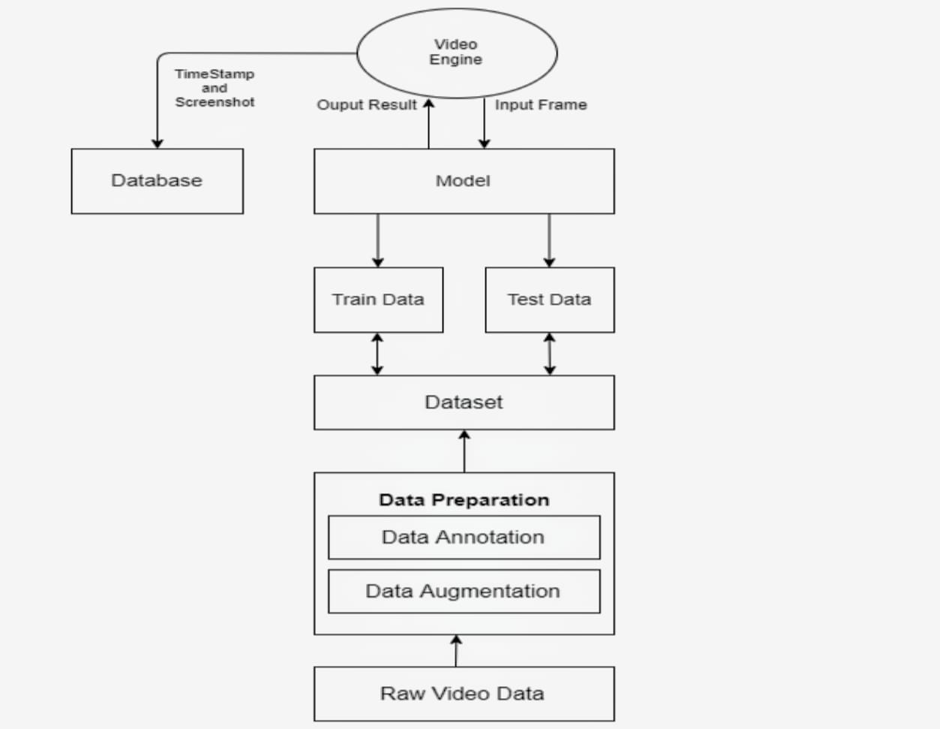
System Architecture

Slide 16
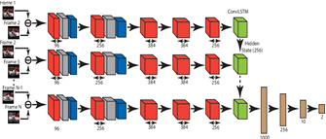
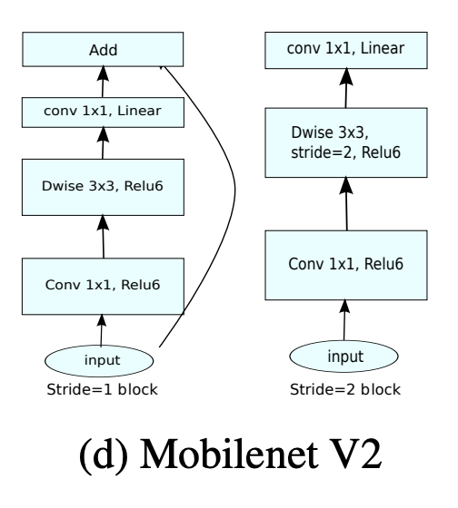
PROPOSED SYSTEM
The network consists of a series of convolutional layers followed by max pooling operations for extracting discriminant features and convolutional long short memory (convLSTM) for encoding the frame level changes, that characterizes violent scenes existing in the video.
The CNN architecture which we have used is MobilenetV2.
MobileNet is a class of CNN that was open-sourced by Google, and therefore, this gives us an excellent starting point for training our classifiers that are insanely small and insanely fast

Slide 17
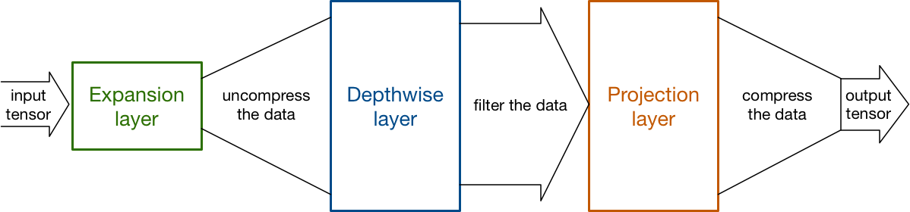
Why MobilenetV2…
There are various neural network architecture like VGG16,VGG19 , Resnet50 , InceptionV3 but we have used MobilenetV2 due to its advantages over other architectures.
MobileNets are a family of neural network architectures released by Google to be used on machines with limited computing power like mobile devices and provides real-time classification.
They strive to provide state of the art accuracy, while requiring as little memory and computing power as possible. This makes them a very fast family of networks to use for image processing.
MobileNets achieve this performance by reducing dramatically the number of learnable parameters, which also makes them faster and easier to train compared to more traditional networks.
It is based on an inverted residual structure where the residual connections are between the bottleneck layers. The intermediate expansion layer uses lightweight depthwise convolutions to filter features as a source of non-linearity. As a whole, the architecture of MobileNetV2 contains the initial fully convolution layer with 32 filters, followed by residual bottleneck layers.

Slide 18
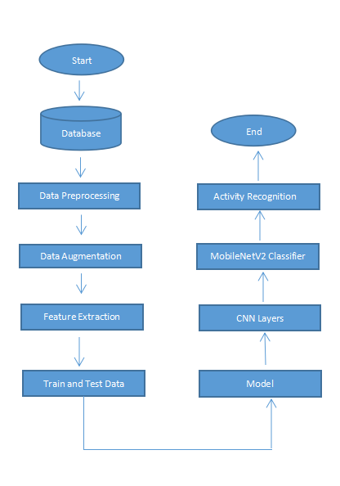
Flowchart :-
Y
N

Slide 19

Sequence Diagram

Slide 20
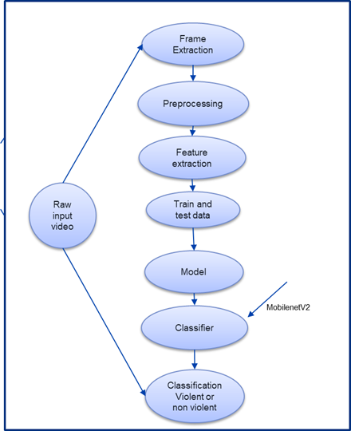
UML Diagram :-

Slide 21
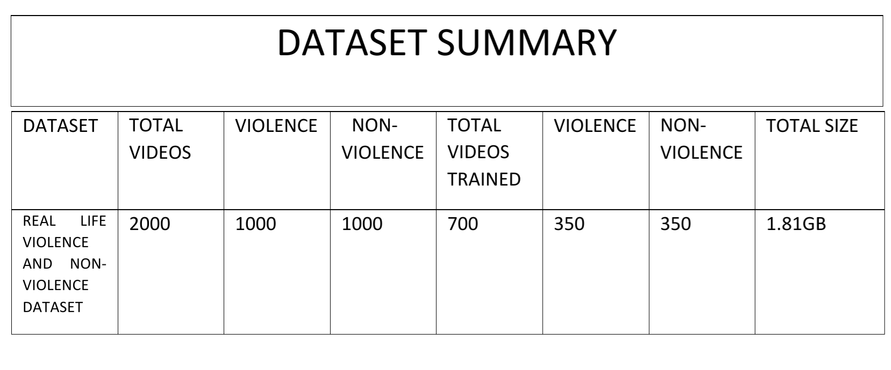
Result and Analysis :- Dataset
The Dataset is composed of 1000 Violence and 1000 non-violence videos collected from youtube videos, violence videos in our dataset contain many real street fights situations in several environments and conditions.
Also non-violence videos from our dataset are collected from many different human actions like sports, eating, walking.This dataset is readily available on Kaggle.
This dataset was uploaded in the drive and then was mounted in google colab.

Slide 22


Result and Analysis :- Snippets

Slide 23
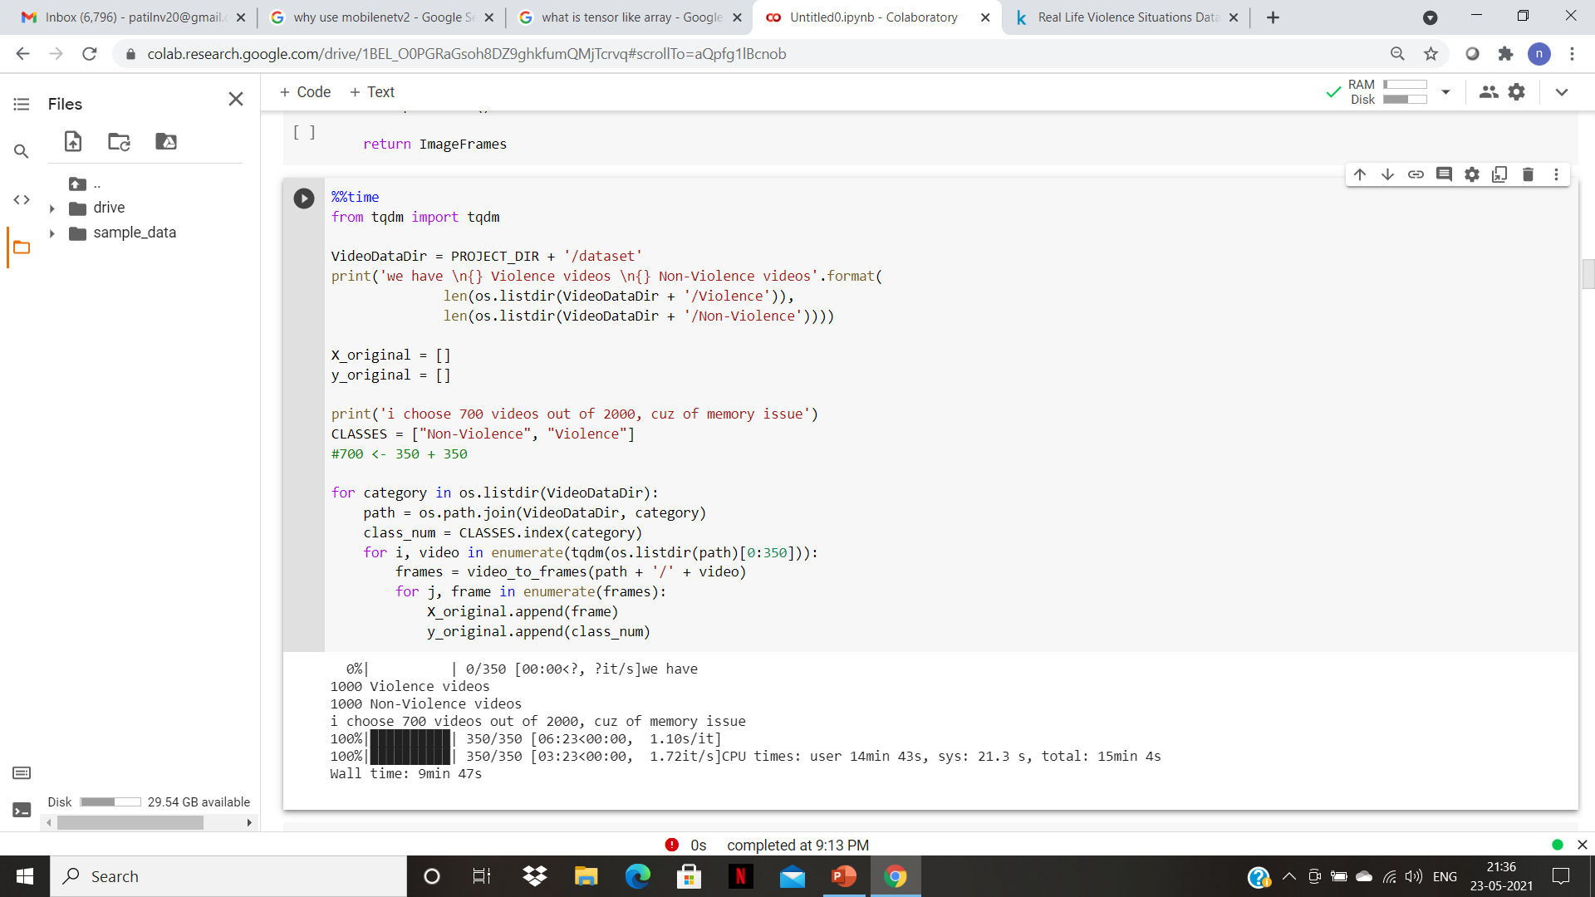
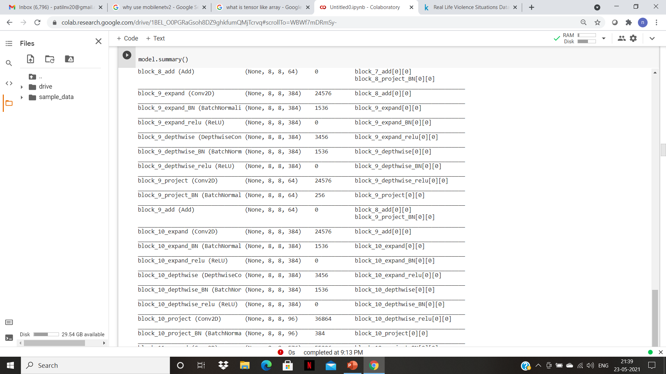
Result and Analysis :- Snippets

Slide 24
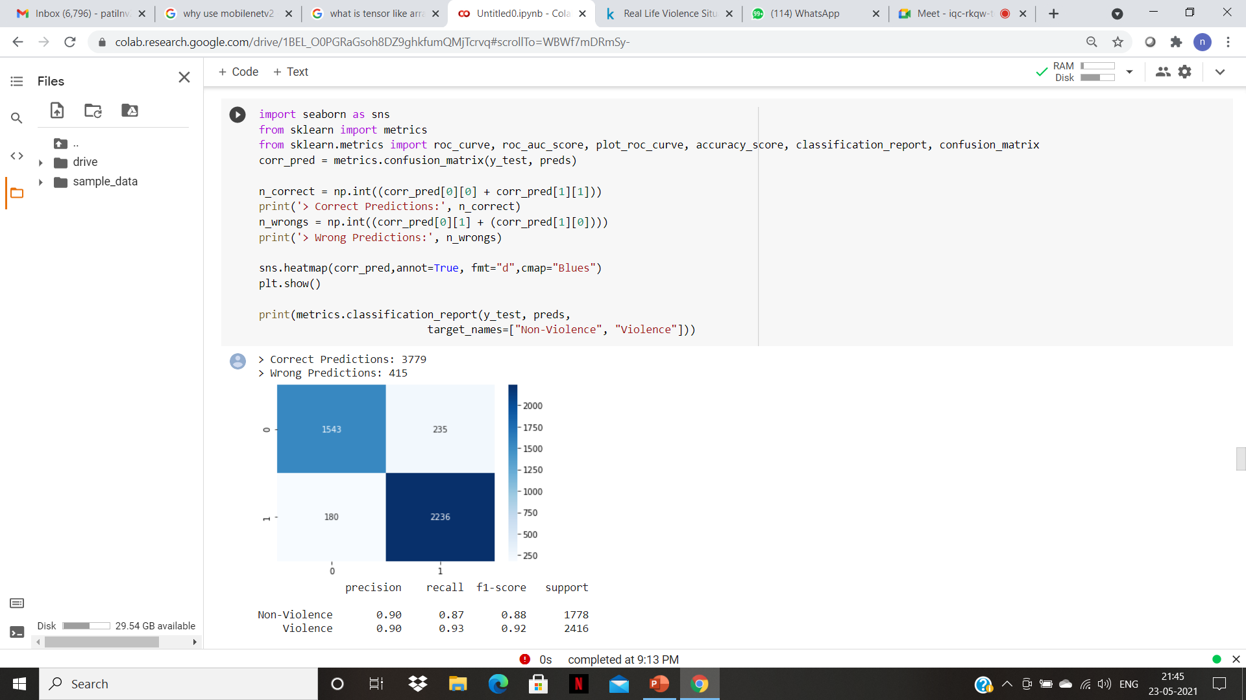
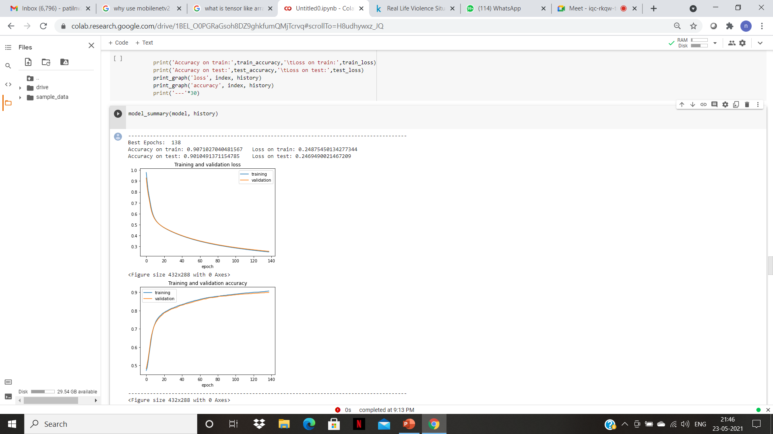
Result and Analysis :- Snippets

Slide 25

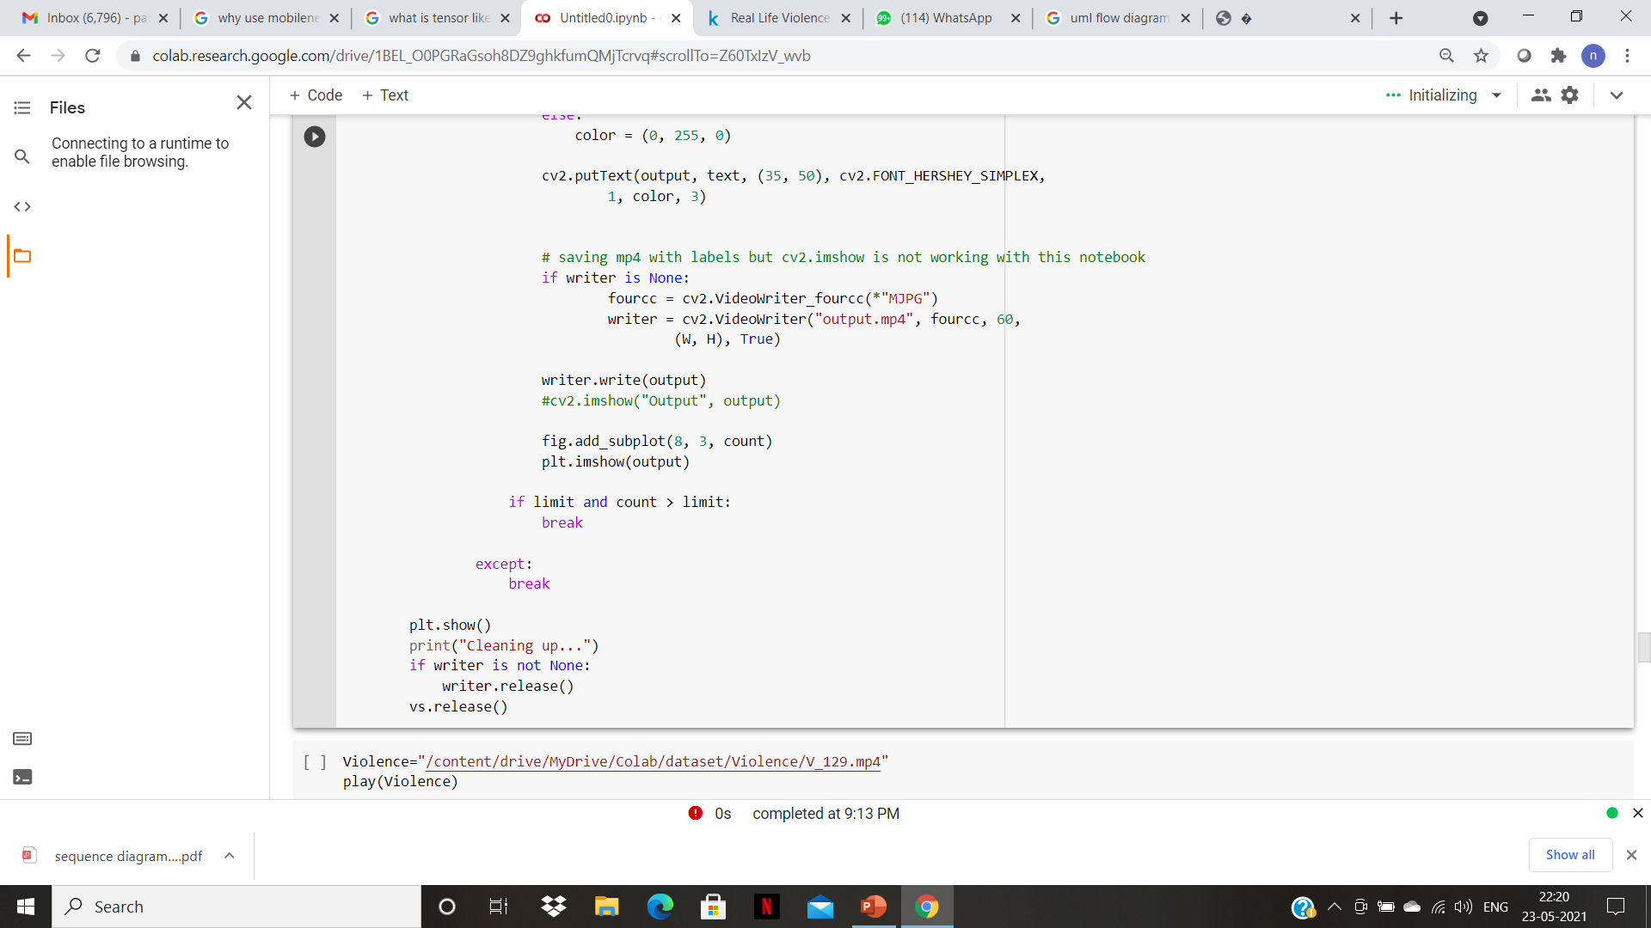
Result and Analysis :- Testing snippets

Slide 26
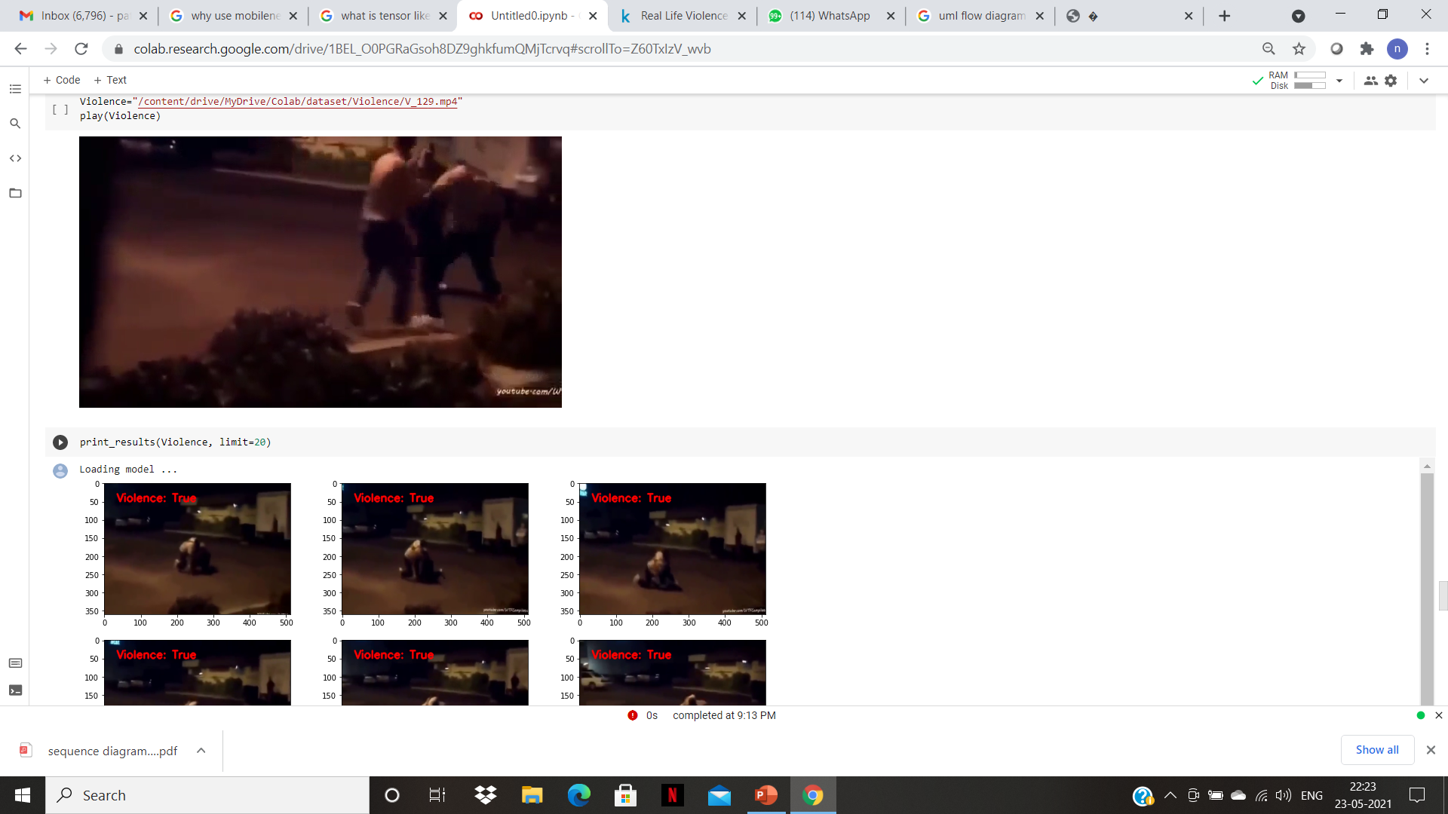
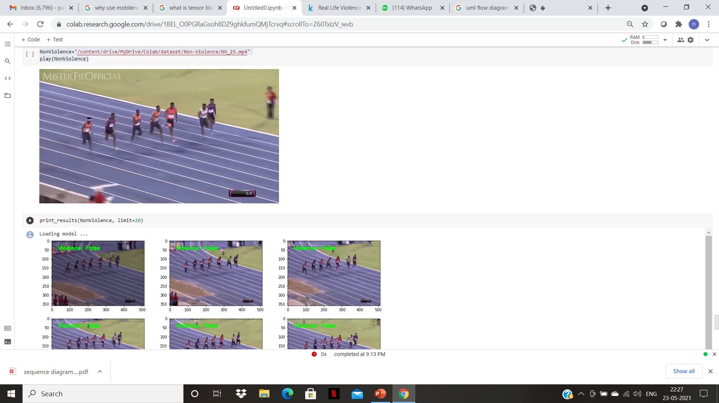
Result and Analysis :- Testing Results

Slide 27
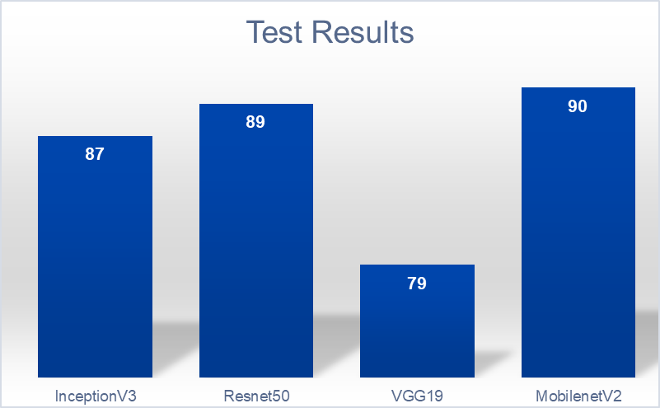
Results and Analysis
Here we have referenced the results and compared these architectural models which have used similar dataset
The most preferred architectures used for CNN are inceptionV3 , Resnet50 , VGG19 due to their heavy hidden layers.
As we can see , the classifer which we have used is at par in terms of accuracy with other models.Also MobileNet is faster and can be reliable over smaller dataset.
Hence MobileNets achieve this performance by reducing dramatically the number of learnable parameters, which also makes them faster and easier to train compared to more traditional networks.

Slide 28
Conclusion :
Therefore we implemented deep learning model to predict violence in video data,
We found that our implementation dealt well with this task even though our GPU
power was relatively low.
The data augmentation process helped the model to deal with the small amount
of labeled data, the augmentation increased the amount of samples and helped the
model to find meaningful patterns in the frames.
Also, we found that retraining the CNN networks improves the performance of the net
work dramatically.
Thus we have proposed an efficient framework which can detect violence in sensitive areas and detect event of violence by analyzing the video streams collected from the various sources.

Slide 29
Future Scope
The planned system solely detects suspicious human behavior
As present and future work, we are evaluating reducing the number of false positives, by preprocessing the videos, i.e. increasing their contrast and luminosity, and also by enriching the training set with weapons in motion
Detection of fire and different weapons can be enforced in future.
Real-time autonomous drone surveillance system can be developed to identify violent individuals in public areas.

Slide 30
References
S.M. Rojin Ammar Md. Tanvir Rounak Anjum Md. Touhidul Islam, "Using Deep Learning Algorithms to Detect Violent Activities”.
https://ieeexplore.ieee.org/document/9014714
https://github.com/liorsidi/violence-detection-deep-learning-cnnlstm
https://arxiv.org/pdf/1702.05147.pdf
Jain, H., Vikram, A., Mohana, Kashyap, A., & Jain, A. (2020). Weapon Detection using Artificial Intelligence and Deep Learning for Security Applications. 2020 International Conference on Electronics and Sustainable Communication Systems (ICESC). doi:10.1109/icesc48915.2020.9155832
https://gramener.com/amle-image-recognition/
https://arxiv.org/pdf/2102.10590.pdf
https://models.roboflow.com/classification/mobilenetv2-classification

Slide 31
Thank You
BY :-
17CS036 : Neeraj Patil
17CS040 : Deepak Pitambare
17CS024 : Amruta Kumbhar
17CS046 : Prachi Sabale

